Slide 1
HALL MANAGEMENT SYSTEM Class Diagram
Presented by
Md Emamul Haque Pranta
1705078

Slide 2
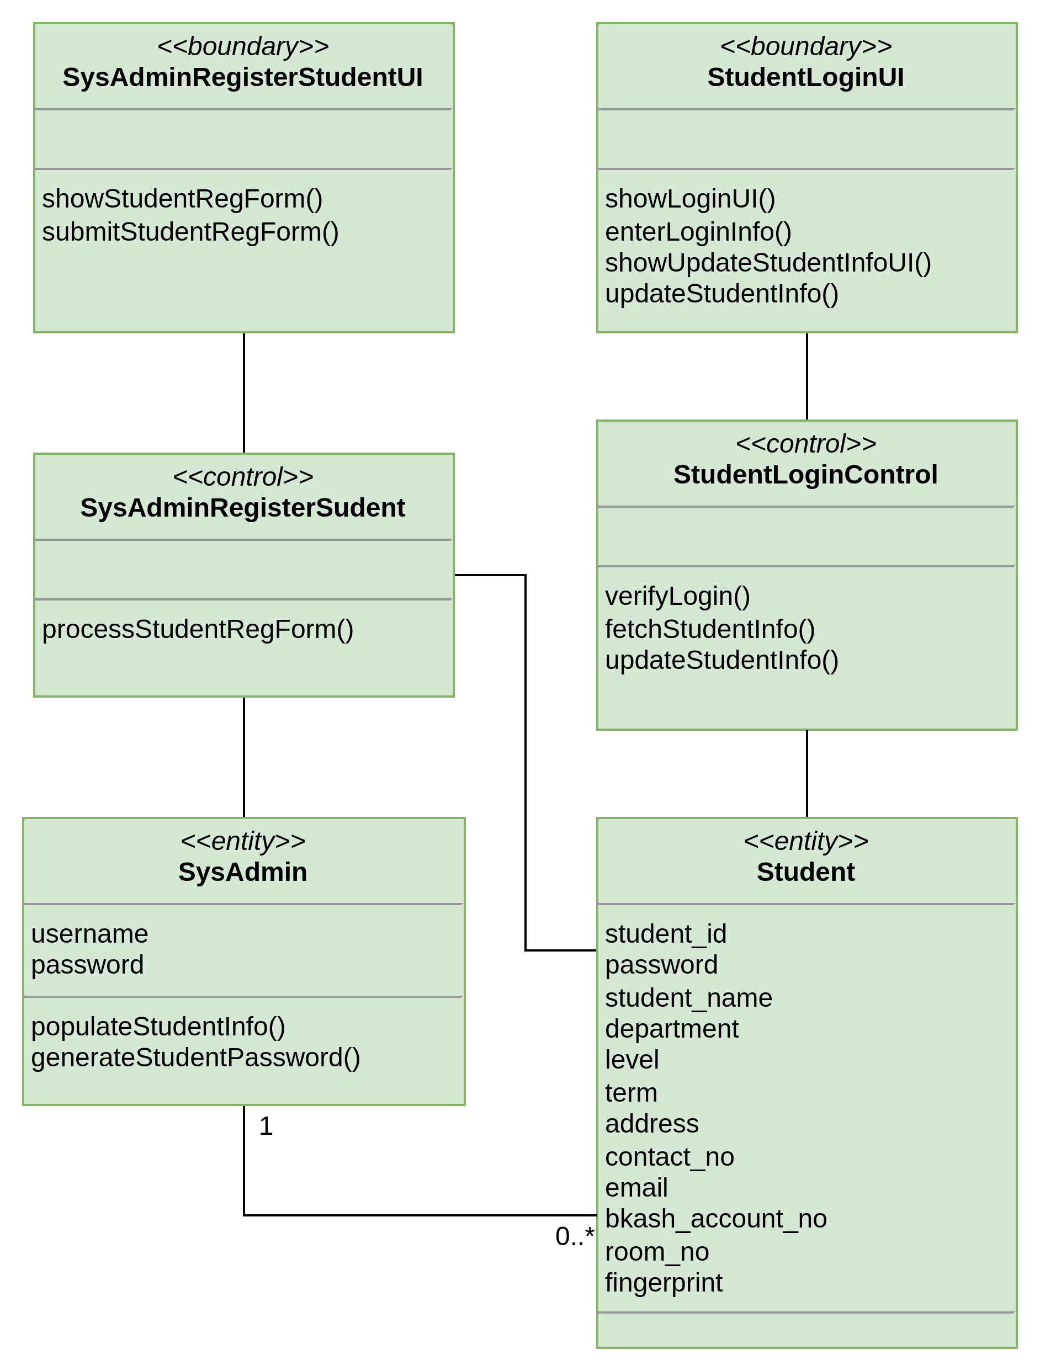
Student Registration & Login

Slide 3
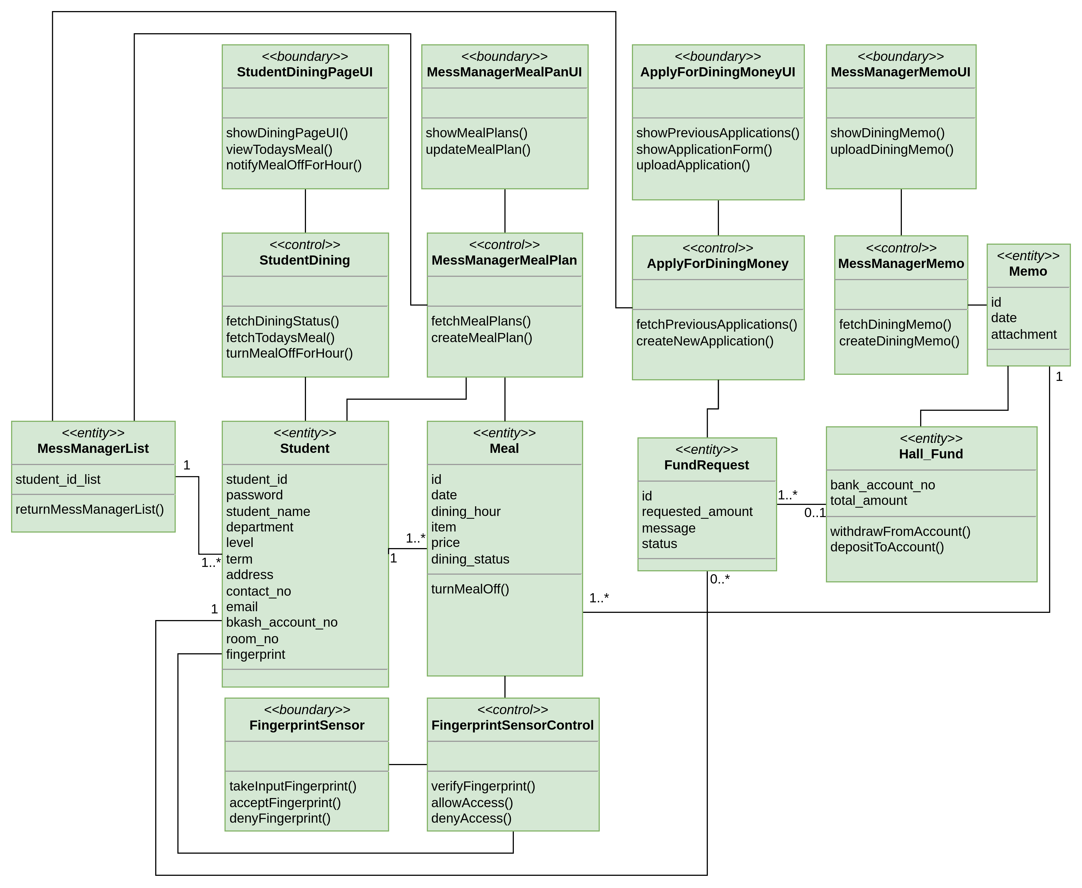
Dining

Slide 4
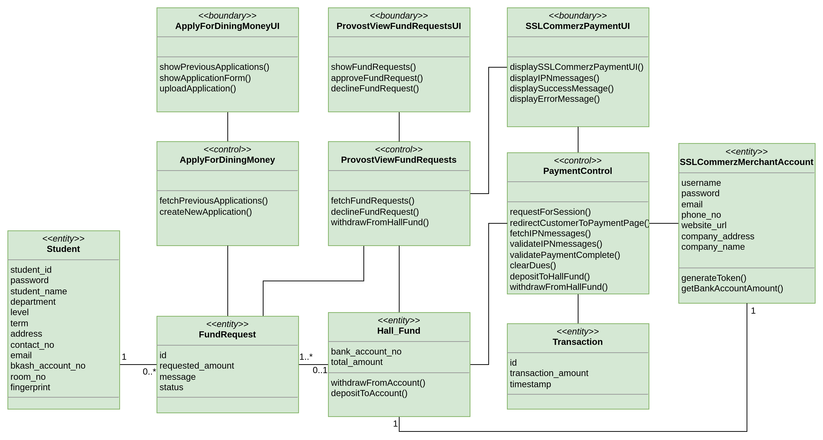
Request for Dining money

Slide 5
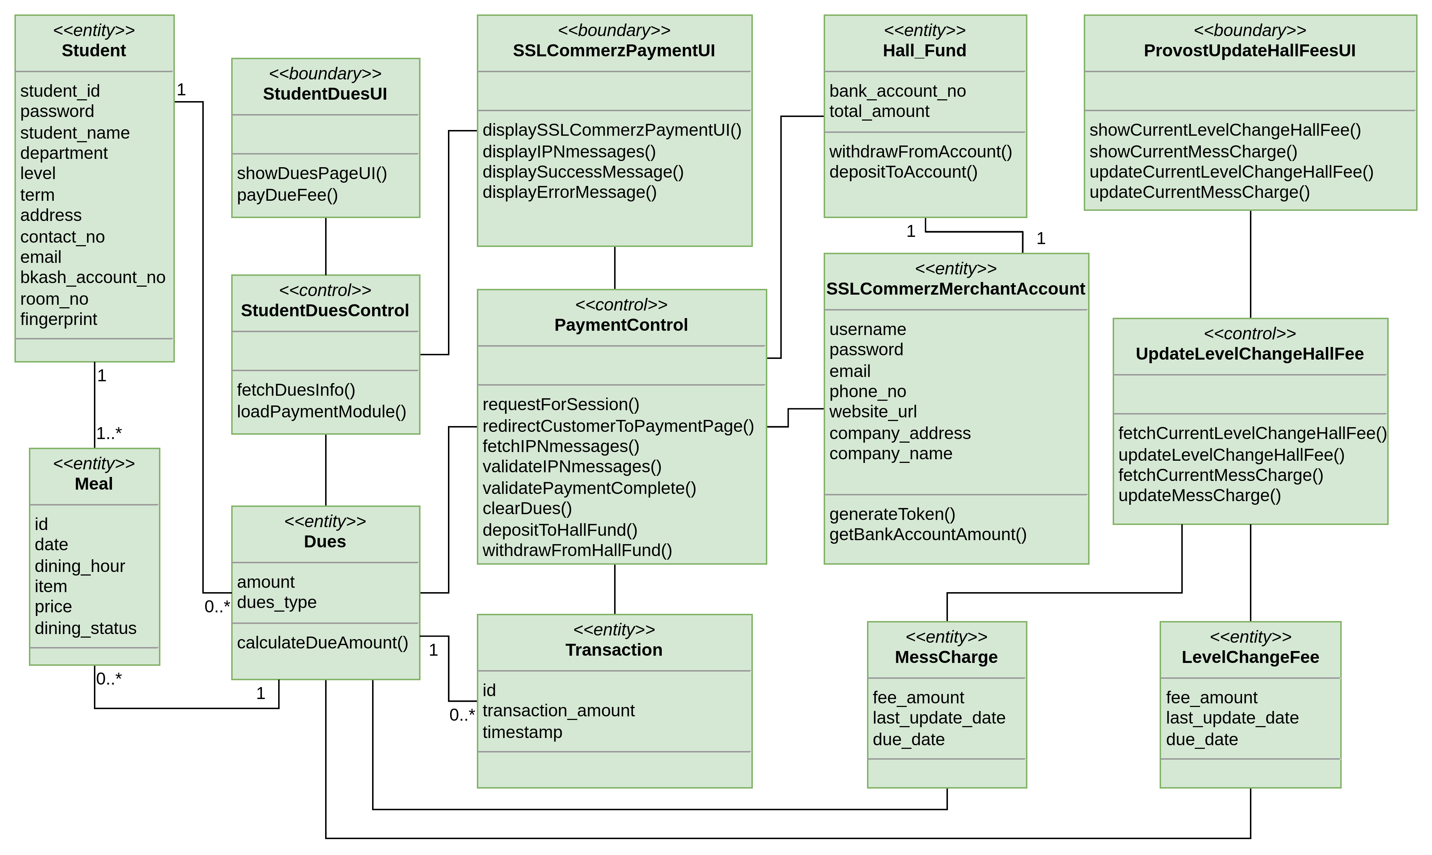
Hall Fees and Dues

Slide 6
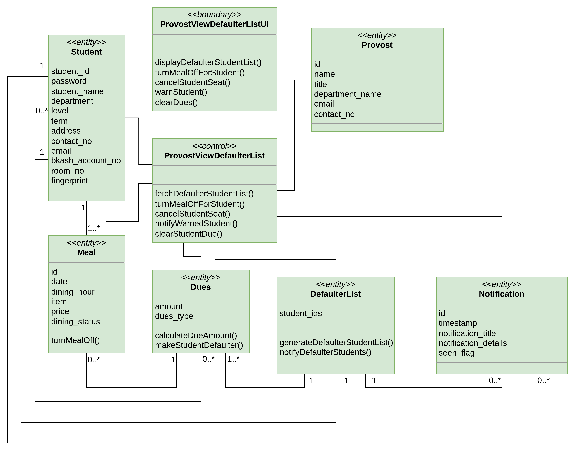
Defaulter List

Slide 7
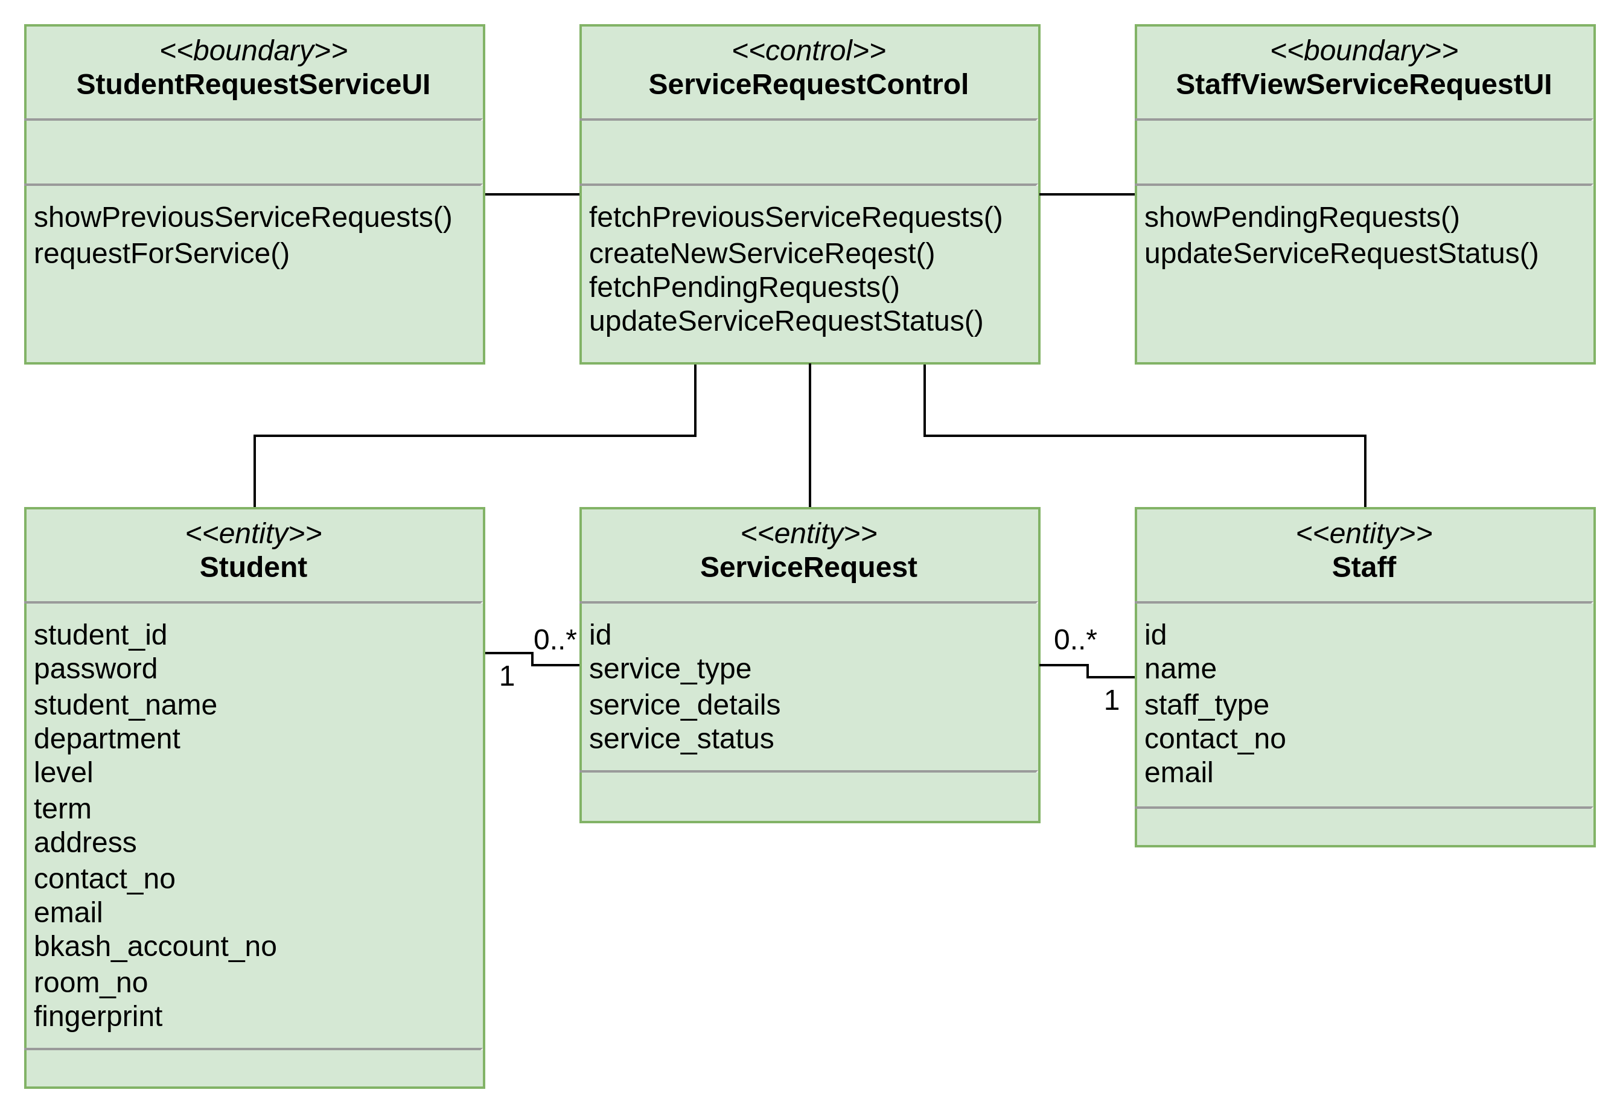
Service Request

Slide 8
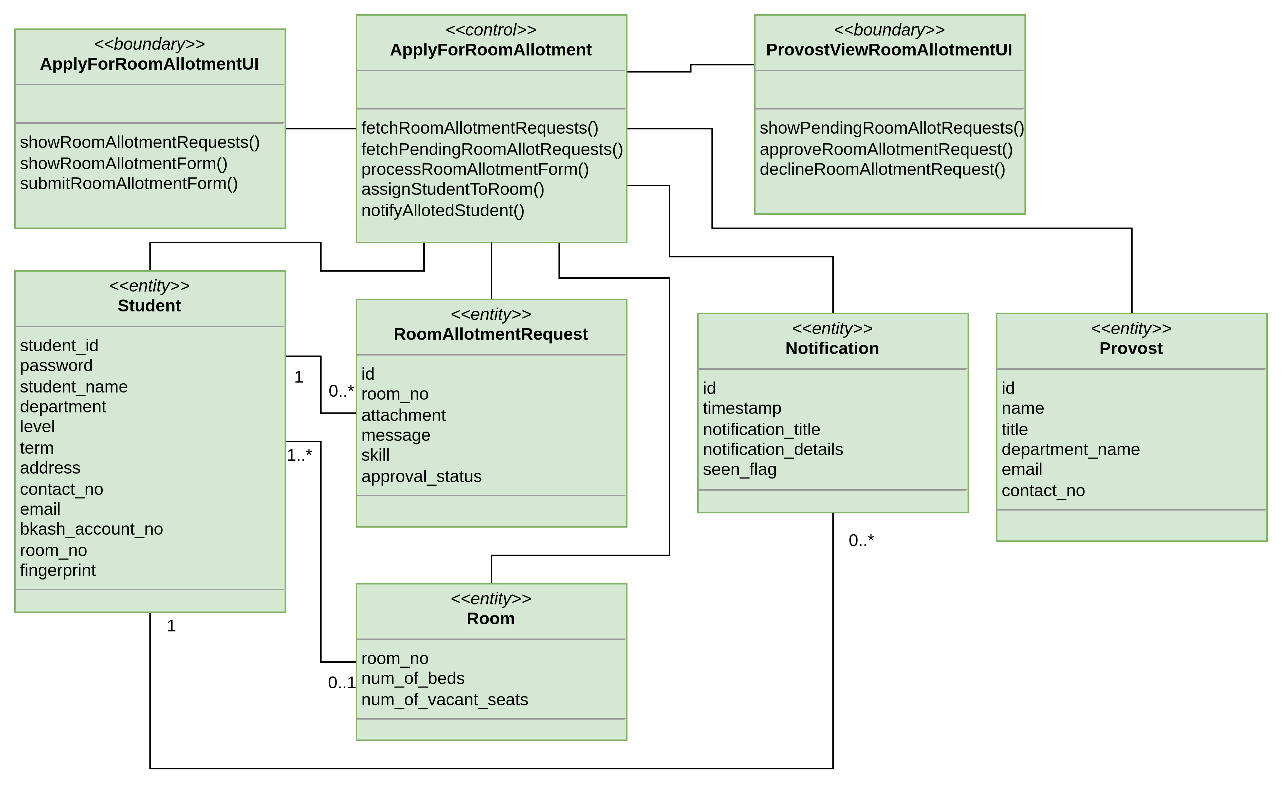
Room Allotment Request

Slide 9
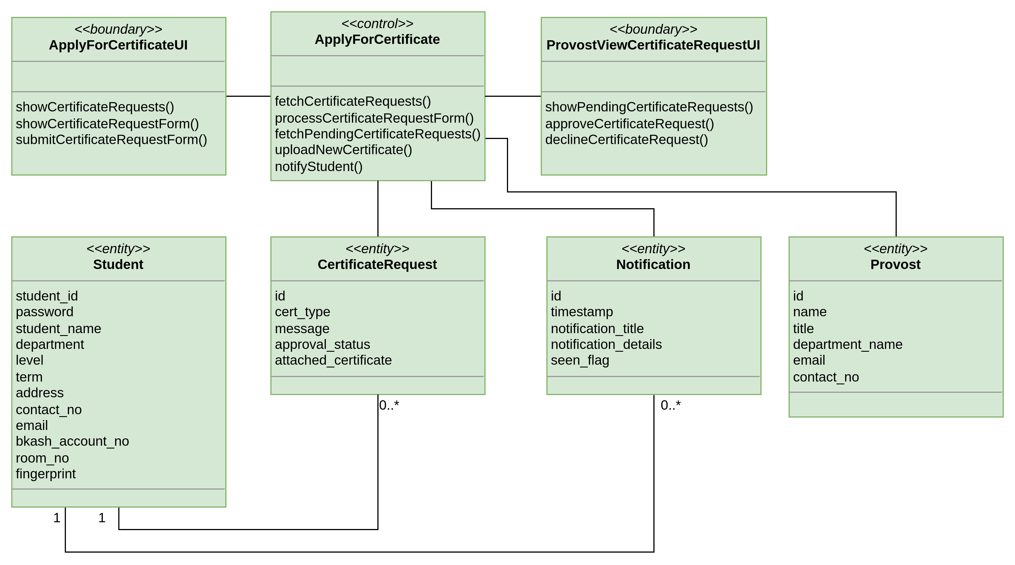
Application for certificate

Slide 10
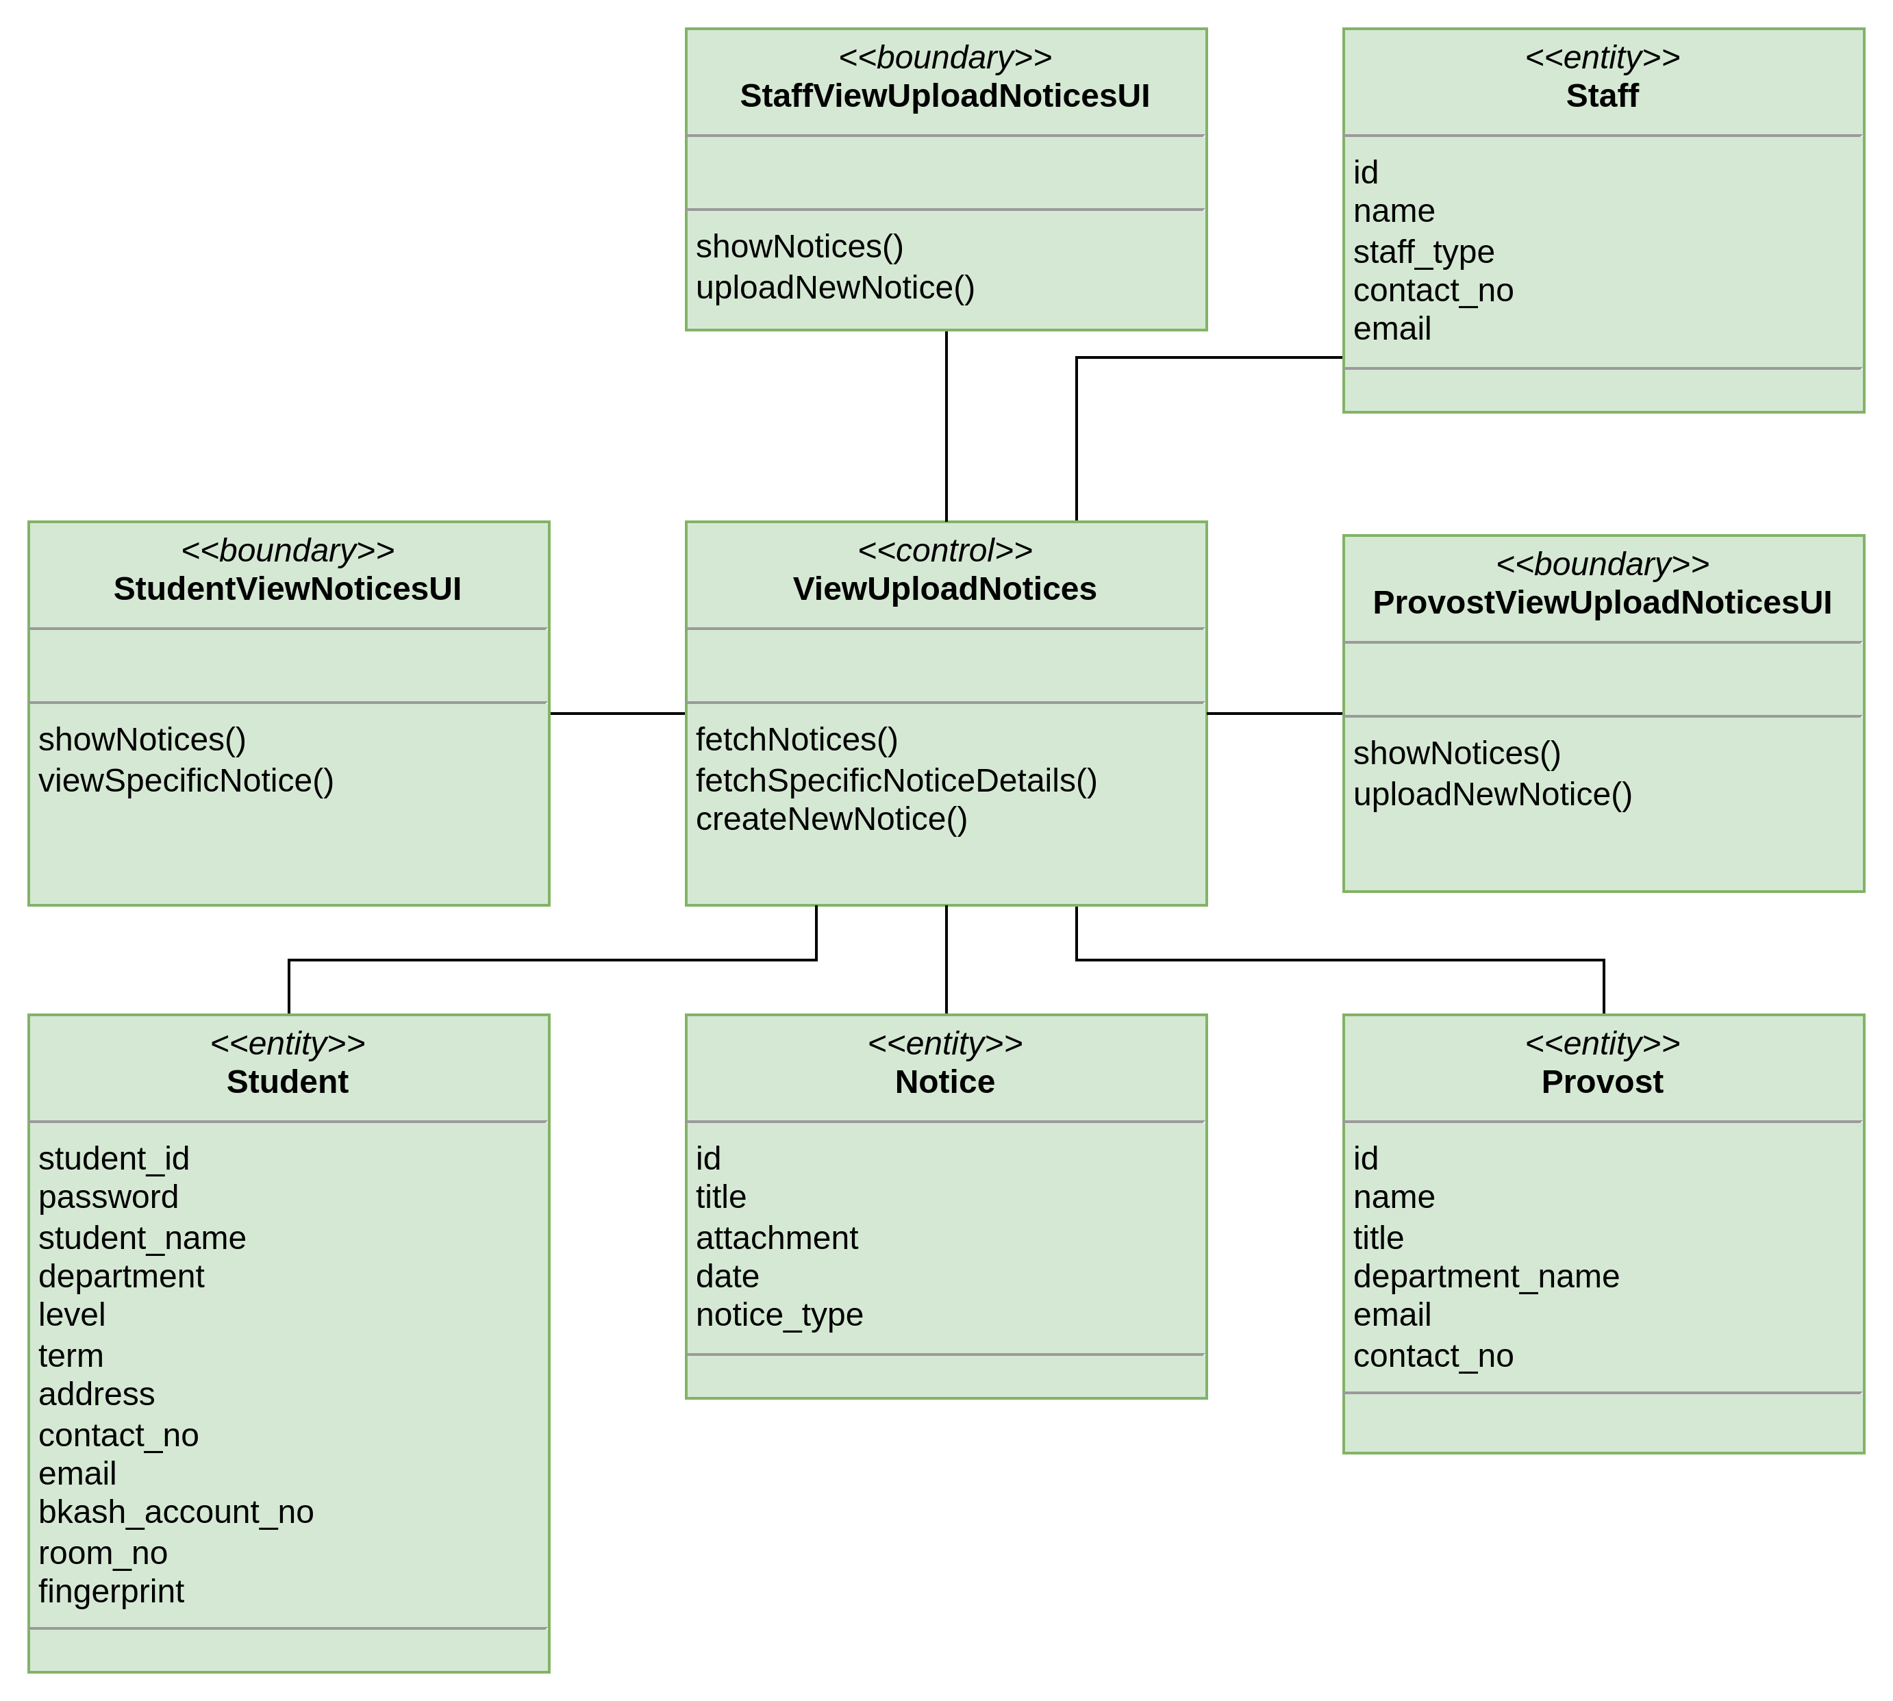
Notice

Slide 11
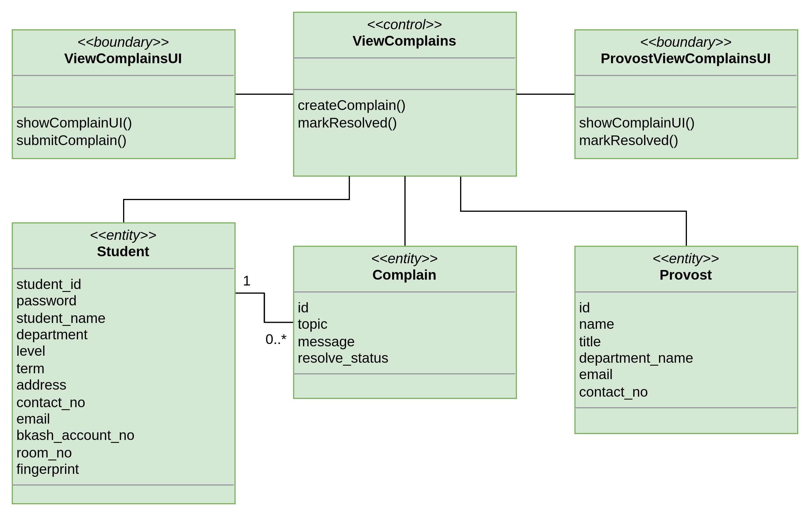
Complains

Slide 12
Complete Class Diagram

Slide 13
Thank you!
Questions are welcome.

